Slide 1


Chevron: Predicting a Cook Plan for Hot Dogs in Gas Stations
Gazi Fuad, Jing Hu, George Lyu

Slide 2
The Problem
Too many hot dogs go wasted because of improper planning...
How many hot dogs should be prepared in advance given past trends to prevent waste?

Slide 3
Visualizations
formulated using MATLAB, Google Colab, Microsoft Excel, and Google Sheets

Slide 4
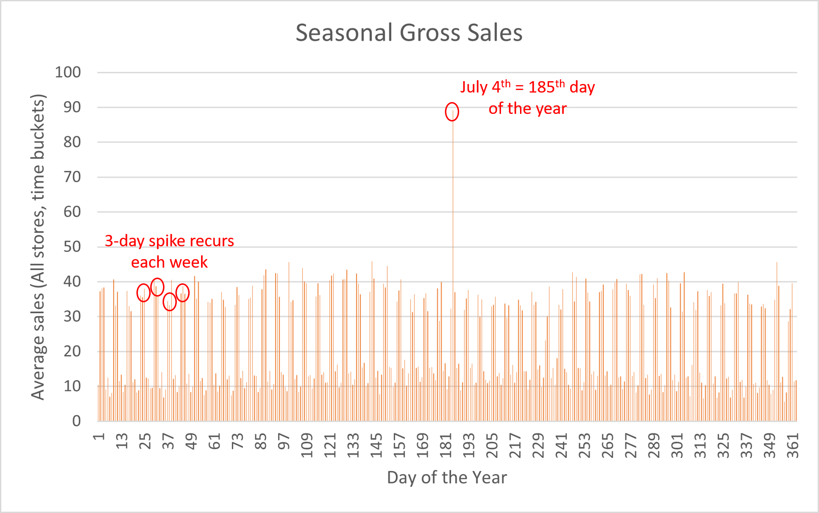

Slide 5
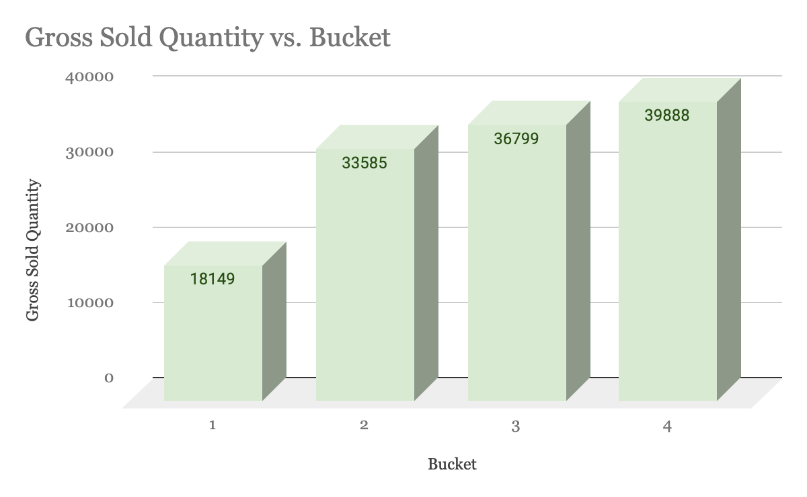

Slide 6
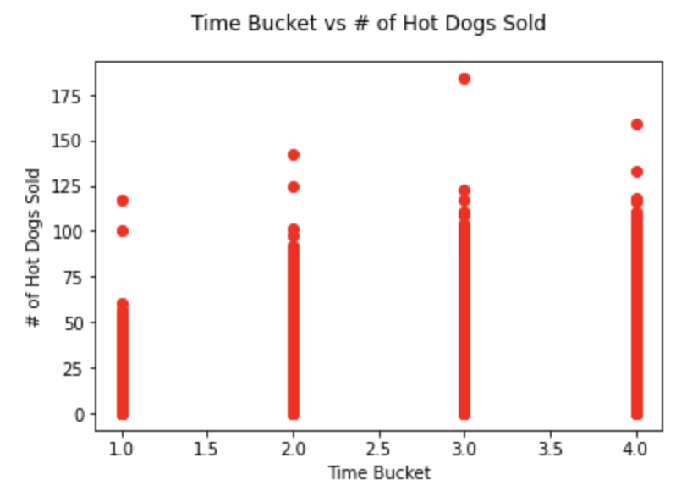
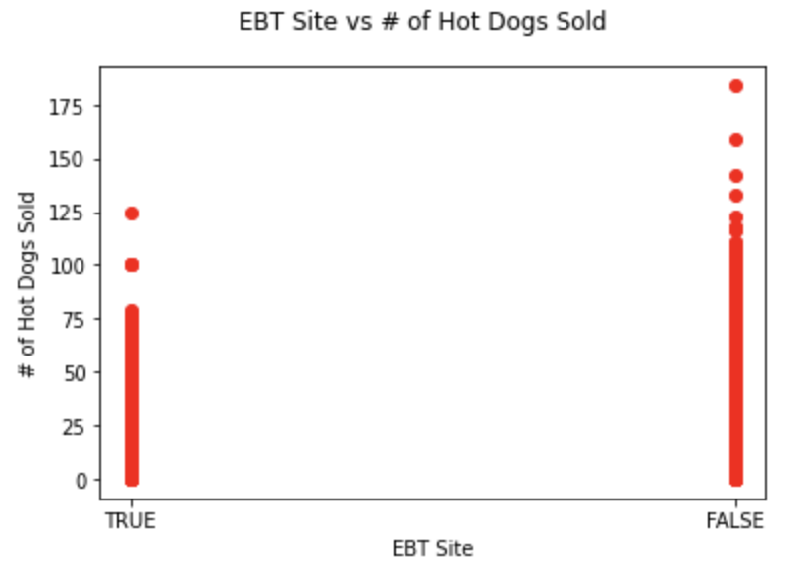
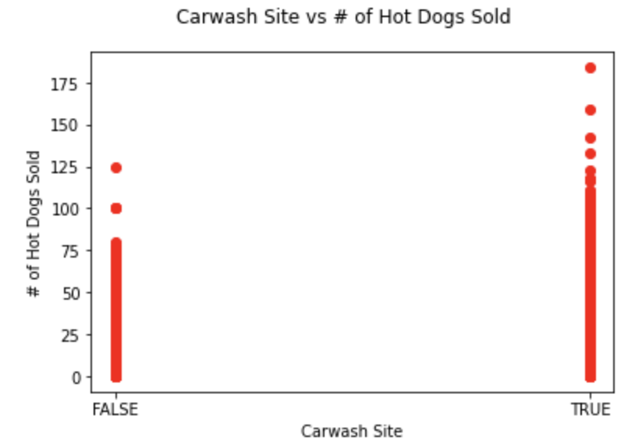
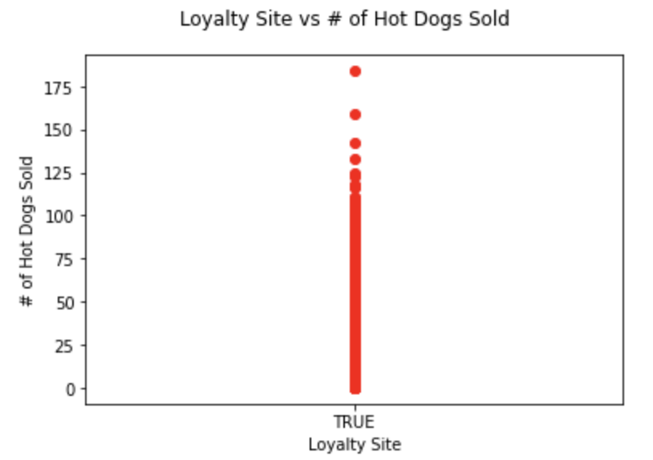
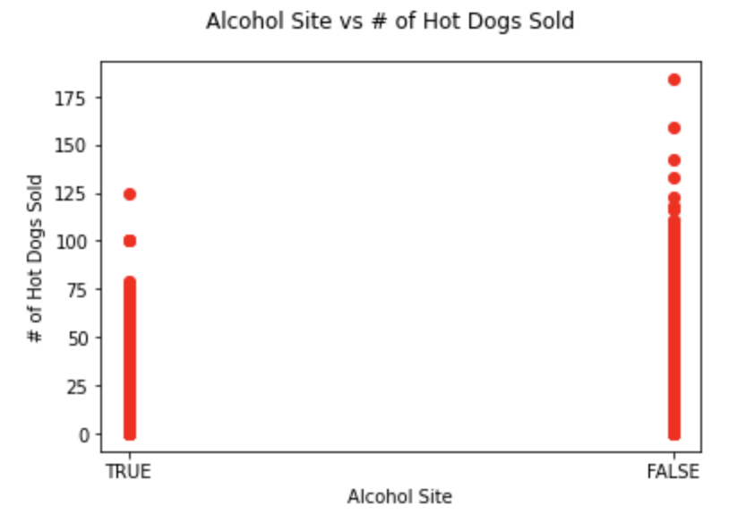

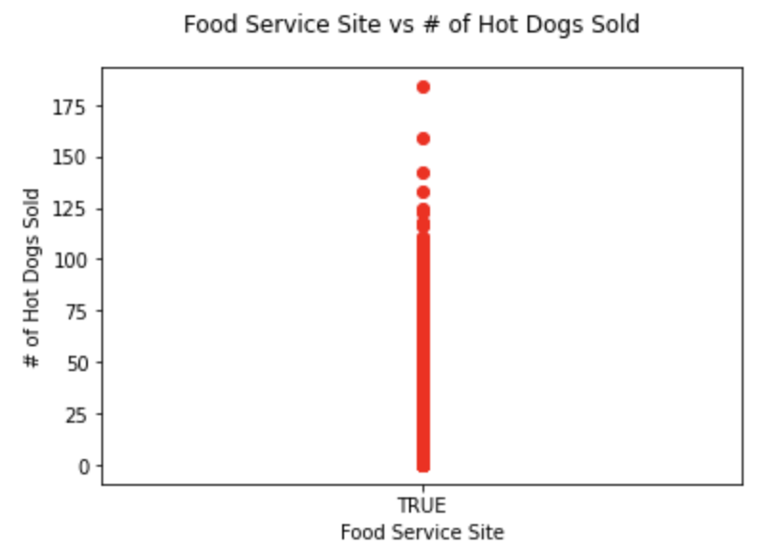
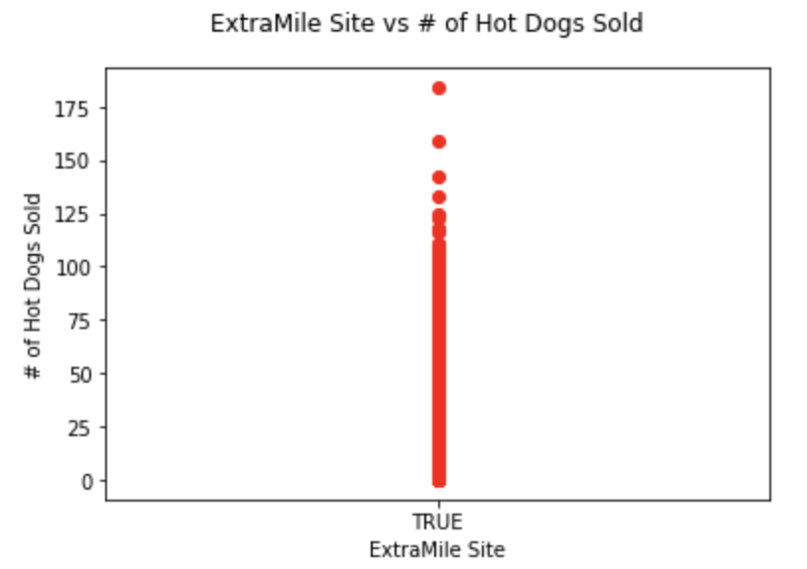

Slide 7
Modeling
Inputs and Outputs
Technique
Results

Slide 8
Model
Inputs:
Store # (categorical)
Time bucket (categorical)
Day of the week (categorical)
July 4th or not (boolean)
EBT Site (boolean)
Alcohol (boolean)
Car Wash (boolean
Output:
Estimated gross hot dog sales (natural number)
Process:
Binary Decision Tree Regression

Slide 9
Technique
Create predictive model by fitting data using Binary Decision Tree Regression.
For any combination of inputs, predict the associated gross hot dog sales.
Round prediction to nearest whole hot dog.
Notes:
decision tree can capture interactions between variables, such as store-exclusive seasonal advertising.

Slide 10
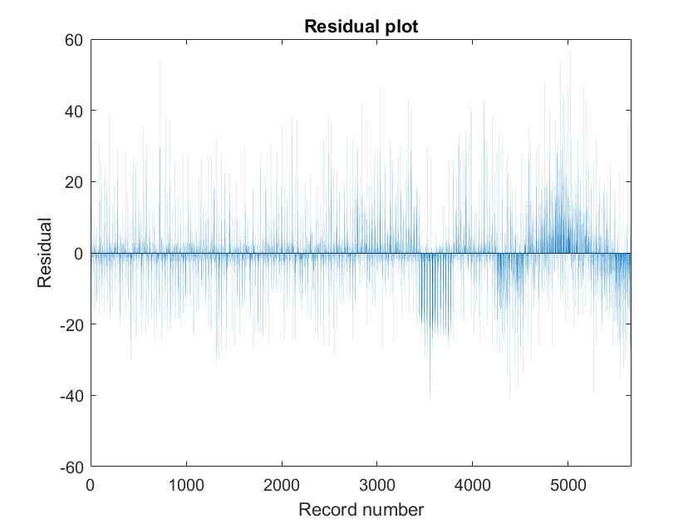
Training Diagnostic Results
After building our model and applying it using training data, we assessed the accuracy of the model with the RMSE (Root Mean Squared Error), residual plot, and the R^2 score.
RMSE: 10.1
R^2 = .80

Slide 11
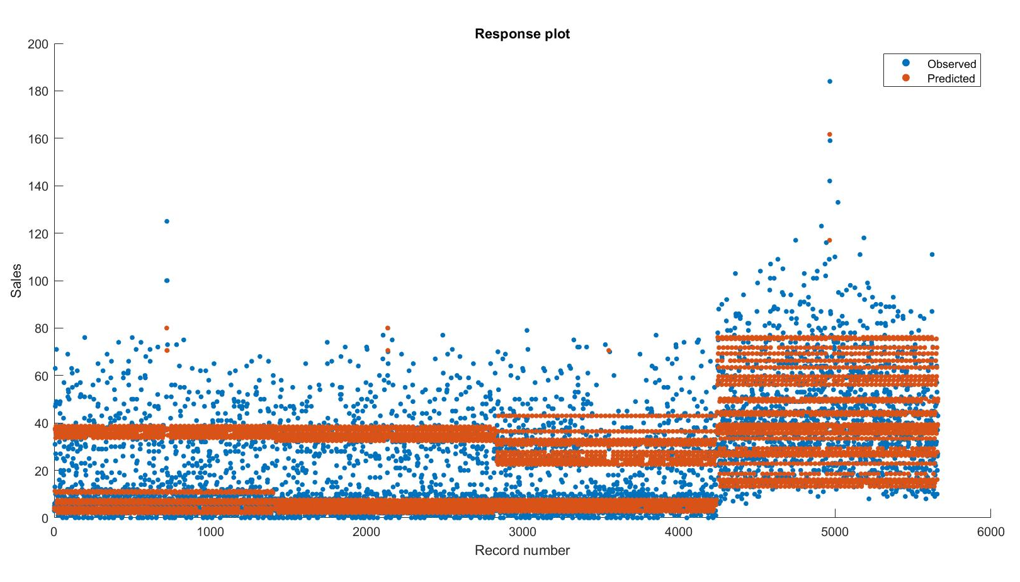
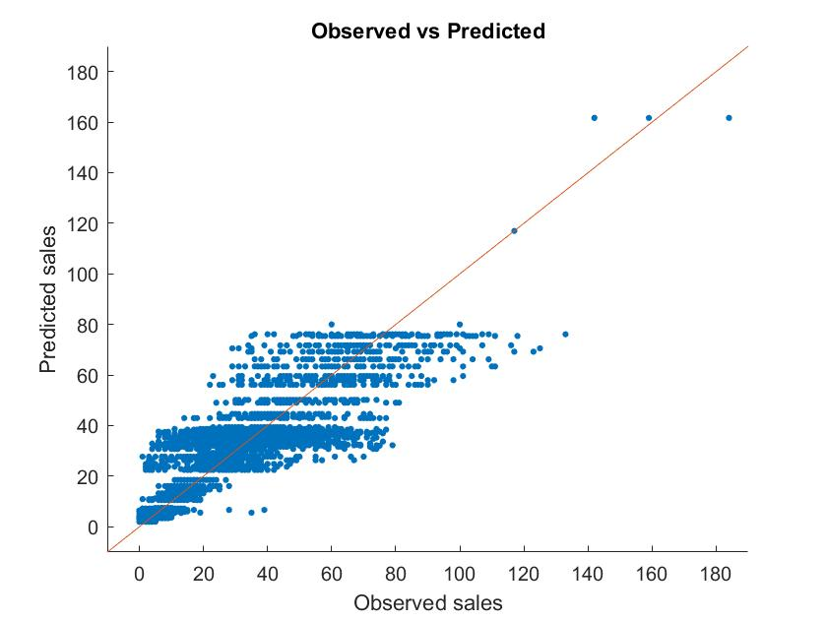

Slide 12
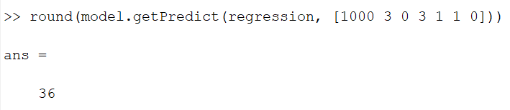
Implementing a Daily Cook Plan (Findings)
Substantially more hot dogs are necessary for Fridays, Saturdays, and Sundays, which have roughly 3 times the sales of weekdays.
Hot dog sales peak on July Fourth. The store must stock 2 times more hot dogs than they do on weekends (6 times as weekdays).
Example of model prediction for: Houston Store #1000, February 6th, Time Bucket #3: 36 hot dogs

Slide 13
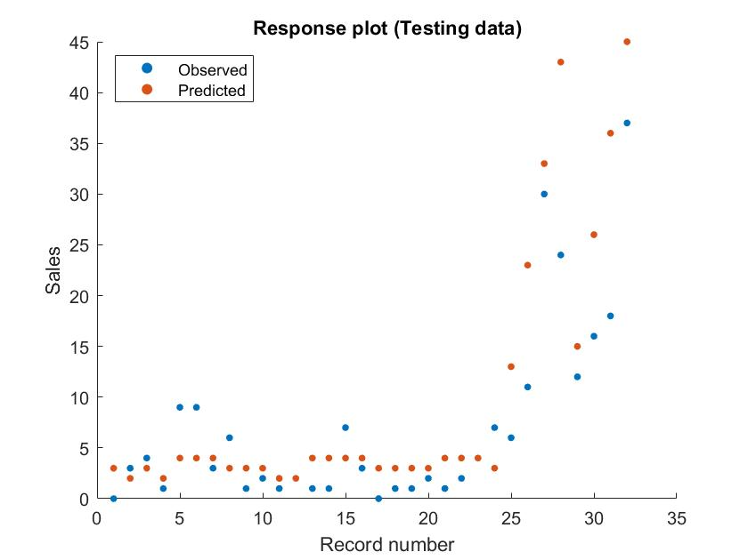
Testing on Scoring Data

Slide 14
Thank you!

